Slide 1
objects, classes, and methods.
Week 6 | Lecture 1 (6.1.1)
While waiting for class to start:
Download and open the Jupyter Notebook (.ipynb) for Lecture 6.1.1
You may also use this lecture’s JupyterHub link instead (although opening it locally is encouraged).
Upcoming:
Reflection 6 released Friday @ 11 AM
Lab 5 due this Friday
Behrang’s Coffee Break / Office Hours Friday @ 1 PM
PRA (Lab) on Friday @ 2PM this week
Exam Review - When is your preference?

Slide 2
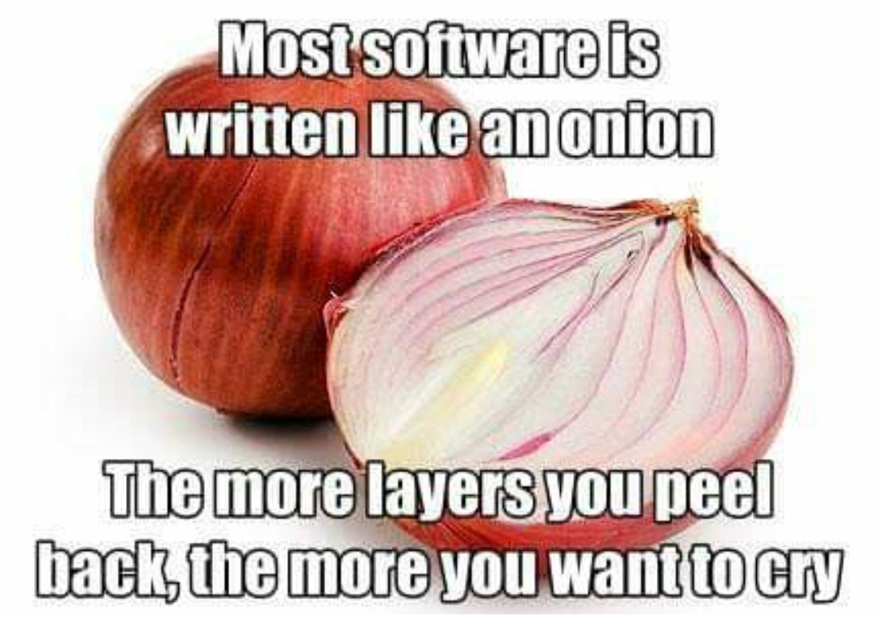
Today’s Content
Lecture 6.1.1
objects, classes, and methods
Lecture 6.1.2
classes in classes!

Slide 3
Procedural vs Object-Oriented
“Object-oriented programming (OOP) is a programming paradigm based on the concept of “objects”, which may contain data, in the form of fields, often known as attributes; and code, in the form of procedures, often known as methods.” — Wikipedia
“Procedural programming is a programming paradigm, derived from structured programming, based upon the concept of the procedure call. Procedures, also known as routines, subroutines, or functions, simply contain a series of computational steps to be carried out.” — Wikipedia

Slide 4

Procedural Programming
Real World
Data
Global Variable
Pedestrian 1
x, y Location
Global Variable
Pedestrian 2
x, y Location
Global Variable
Pedestrian 3
x, y Location
x_ped1 = 3
y_ped1 = 5
Global Variable
Traffic Light 1
Color
Global Variable
Car 1
x, y location
traffic_light = ‘red’
Separation of Data and Functions
Function
OK to Cross
Function
Advance Position
Function
Pedestrian in Intersection

Slide 5
Procedural Programming
Real World
Data
Global Variable
Pedestrian 1
x, y Location
Global Variable
Pedestrian 2
x, y Location
Global Variable
Pedestrian 3
x, y Location
Global Variable
Traffic Light 1
Color
Global Variable
Car 1
x, y location
input
output
Function
OK to Cross
Function
Advance Position
Function
Pedestrian in Intersection

Slide 6
Object-Oriented Programming
Real World
Data
Car Object
x, y Location
Pedestrian in Intersection
Advance Position
Traffic Light Object
Color
Change Color
Encapsulation of Data and Functions
Pedestrian Object
x, y Location
Ok to Cross
Advance Position
Pedestrian Object
x, y Location
Ok to Cross
Advance Position
Pedestrian Object
x, y Location
Ok to Cross
Advance Position

Slide 7
Object-Oriented Programming
Often, an object definition corresponds to some object or concept in the real world.
The functions that operate on that object correspond to the ways real-­world objects interact.
Examples:
Oven Object: the oven allows several specific operations, e.g., set the temperature, set a timer, etc.
Cellphone Object: we use a cellphone’s own “methods” to send a text message, or to change its state to silent.
Turtle Object: we use a turtle’s own “methods” to move around a 2D space.

Slide 8
Object-Oriented Programming
Data
Functions
def up(y):
return y + 1
def goto(x_new, y_new):
return x_new, y_new
def right(x):
return x + 1
Procedural
Object-Oriented
x = 0
y = 0
y = up(y)
x, y = goto(-150, 100)
x = right(x)
print(x, y)
alex = Turtle(0, 0)
alex.up()
alex.goto(-150, 100)
alex.right()
print(alex.x, alex.y)

Slide 9
Objects in Python
Is this an instance
of this class.
Everything in Python is an object.
Every value, variable, function, etc., is an object.
Every time we create a variable we are making a new object.
>>> isinstance(4, object)
True
>>> isinstance(max, object)
True
>>> isinstance(“Hello”, object)
True

Slide 10
Objects in Python
Is this an instance
of this class.
Each object has a type or class it is associated with.
>>> isinstance(“Hello”, str)
True
>>> isinstance(4, int)
True
>>> isinstance(4, float)
False
>>> isinstance(4.0, float)
True
>>> isinstance([1, 2], list)
True

Slide 11
Objects in Python
Really? Everything is an object?
Open your notebook
Click Link:
1. Objects in Python

Slide 12
Classes
Class
A class can be thought of as a template for the objects that are instances of it.
An instance of a class refers to an object whose type is defined as the class.
The words "instance" and "object" are used interchangeably.
A Class is made up of attributes (data) and methods (functions).
Attributes
Data
Methods
Functions
append(list1, list2)
list1.append(list2)

Slide 13

Classes
Person
Instances (objects) of the Person class.
name
age
city
gender
name: Majid
age: 28
city: Toronto
gender: they/them
name: June
age: 34
city: Ottawa
gender: she/her
eat
study
sleep
play
name: Ted
age: 31
city: Kingston
gender: he/him

Slide 14
Classes
Person
Instances (objects) of the Person class.
Object.
Instance of the Person Class.
name
age
city
gender
Class.
name: June
age: 34
city: Ottawa
gender: she/her
june = Person(‘June’, 34,
‘Ottawa’,
‘she/her’)
type(june)
>>> Person
eat
study
sleep
play
Class.

Slide 15



Classes
Car
Instances (objects) of the Car class.
model: Model S
company: Tesla
year: 2017
color: blue
model
company
year
color
model: Corolla
company: Toyota
year: 1980
color: red
brake
accelerate
change oil
open trunk
model: Bus
company: Volkswagen
year: 1976
color: orange

Slide 16
Classes
Car
Instances (objects) of the Car class.
Object.
Instance of the Car Class.
model
company
year
color
Class.
model: Corolla
company: Toyota
year: 1980
color: red
mycar = Car(‘Corolla’,
‘Toyota’,
1980,
‘red’)
type(mycar)
>>> Car
brake
accelerate
change oil
open trunk
Class.

Slide 17

Classes
Turtle
Instances (objects) of the Turtle class.
name
x location
y location
name: Vinodh
x location: 134
y location: 45
name: Lucy
x location: 24
y location: 35
move up
move down
move left
move right
go to
name: Brian
x location: 92
y location: 62

Slide 18
Classes
Turtle
Instances (objects) of the Turtle class.
Object.
Instance of the Turtle Class.
name
x location
y location
Class.
name: Lucy
x location: 24
y location: 35
turtle = Turtle(‘Lucy’,
24,
35)
type(turtle)
>>> Turtle
move up
move down
move left
move right
go to
Class.

Slide 19

Classes
File
Instances (objects) of the file class.
name
mode
name: itinerary.txt
mode: write
name: bills.txt
mode: append
read
readline
readlines
name: grades.txt
mode: read

Slide 20
Classes
File
Instances (objects) of the file class.
Object.
Instance of the File Class.
name
mode
Class.
name: bills.txt
mode: append
myfile = File(‘bills.txt’)
type(myfile)
>>> File
read
readline
readlines
Class.

Slide 21
Classes
class Name:
def __init__(self, param1, param2, …):
self.param1 = param1
self.param2 = param2
…
body
def method1(self, parameters):
body
def method2(self, parameters):
body
def method3(self, parameters):
body
General form of a Class:
Class Name
CamelCase
CourseGrades
BankAccount
FlightStatus
XRayImage
Constructor
Methods

Slide 22
Classes
class Turtle:
def __init__(self, x, y):
self.x = x
self.y = y
def up(self):
body
def goto(self, x, y):
body
def down(self):
body
alex = Turtle(0, 0)
alex.up()
alex.goto(-150, 100)
alex.down()
print(alex.x, alex.y)

Slide 23
Definition Recap
Class
Object
Instantiate
Method
Attribute
Constructor
self
Let’s formally cover some important definitions.

Slide 24
Definition Recap
Class
Object
Instantiate
Method
Attribute
Constructor
self
Template for creating objects.
class Name:
def __init__(self, param1, param2, …):
self.param1 = param1
self.param2 = param2
…
body
def method1(self, parameters):
body
def method2(self, parameters):
body
def method3(self, parameters):
body

Slide 25
Definitions
class Turtle:
def __init__(self, x, y):
self.x = x
self.y = y
def up(self):
body
def goto(self, x, y):
body
def down(self):
body
Class
Object
Instantiate
Method
Attribute
Constructor
self
An instance of a class.
alex = Turtle(0, 0)
alex is an instance of the Turtle class.

Slide 26
Definition Recap
Class
Object
Instantiate
Method
Attribute
Constructor
self
Creating (constructing) an instance of a class.
alex = Turtle(0, 0)
This is the process of instantiating.

Slide 27
Definition Recap
Class
Object
Instantiate
Method
Attribute
Constructor
self
A function defined in a class.
def goto(x, y):
body
class Turtle:
def __init__(self, x, y):
self.x = x
self.y = y
def goto(self, x, y):
body
Function
Method

Slide 28
Definitions
class Turtle:
def __init__(self, x, y):
self.x = x
self.y = y
def up(self):
body
def goto(self, x, y):
body
def down():
body
Class
Object
Instantiate
Method
Attribute
Constructor
self
A variable bound to an instance of a class.
alex = Turtle(0, 0)
alex.x
alex.y
Attributes

Slide 29
Definitions
class Turtle:
def __init__(self, x, y):
self.x = x
self.y = y
def up(self):
body
def goto(self, x, y):
body
def down(self):
body
Class
Object
Instantiate
Method
Attribute
Constructor
self
Responsible for setting up the initial state of a new instance.
alex = Turtle(0, 0)
alex.x
alex.y
__init__ method is automatically run during instantiation.

Slide 30
Definitions
class Turtle:
def __init__(self, x, y):
self.x = x
self.y = y
def up(self):
body
def goto(self, x, y):
body
def down(self):
body
Class
Object
Instantiate
Method
Attribute
Constructor
self
Reference to the instance of the class.
Although you do not technically need to use the word self, it is widely adopted and is recommended.
Understanding self is a challenge for most students so don’t worry if you’re confused.
More on self next lecture.

Slide 31
Definitions
class Turtle:
def __init__(self, x, y):
self.x = x
self.y = y
def up(self):
body
def goto(self, x, y):
body
def down(self):
body
Class
Object
Instantiate
Method
Attribute
Constructor
self
katia = Turtle(0, 0)
print(katia.x, katia.y)
joseph = Turtle(-4, 1)
print(joseph.x, joseph.y)

Slide 32
Definitions
class Turtle:
def __init__(self, x, y):
self.x = x
self.y = y
def up(self):
body
def goto(self, x, y):
body
def down(self):
body
Class
Object
Instantiate
Method
Attribute
Constructor
self
self
katia = Turtle(0, 0)
print(katia.x, katia.y)
joseph = Turtle(-4, 1)
print(joseph.x, joseph.y)

Slide 33
Definitions
katia is self
Inside Class
self.attribute
self.method
Class
Object
Instantiate
Method
Attribute
Constructor
self
class Turtle:
def __init__(self, x, y):
self.x = x
self.y = y
def up(self):
...
def goto(self, x, y):
...
...
def get_position(self):
...
def print_position(self):
...
Outside Class
katia.attribute
katia.method
katia = Turtle(0, 0)
katia.up()

Slide 34
Definitions
katia is self
Inside Class
self.attribute
self.method
Class
Object
Instantiate
Method
Attribute
Constructor
self
class Turtle:
def __init__(self, x, y):
self.x = x
self.y = y
def up(self):
self.y += 1
def goto(self, x, y):
...
...
def get_position(self):
...
def print_position(self):
...
Outside Class
katia.attribute
katia.method
katia = Turtle(0, 0)
katia.up()

Slide 35
Definitions
katia is self
Inside Class
self.attribute
self.method
Class
Object
Instantiate
Method
Attribute
Constructor
self
class Turtle:
def __init__(self, x, y):
self.x = x
self.y = y
def up(self):
self.y += 1
def goto(self, x, y):
...
...
def get_position(self):
...
def print_position(self):
...
Outside Class
katia.attribute
katia.method
katia = Turtle(0, 0)
katia.up()
katia.goto(-2, 10)

Slide 36
Definitions
katia is self
Inside Class
self.attribute
self.method
Class
Object
Instantiate
Method
Attribute
Constructor
self
class Turtle:
def __init__(self, x, y):
self.x = x
self.y = y
def up(self):
self.y += 1
def goto(self, x, y):
self.x = x
self.y = y
def get_position(self):
...
def print_position(self):
...
Outside Class
katia.attribute
katia.method
katia = Turtle(0, 0)
katia.up()
katia.goto(-2, 10)

Slide 37
Definitions
katia is self
Inside Class
self.attribute
self.method
Class
Object
Instantiate
Method
Attribute
Constructor
self
class Turtle:
def __init__(self, x, y):
self.x = x
self.y = y
def up(self):
self.y += 1
def goto(self, x, y):
self.x = x
self.y = y
def get_position(self):
...
def print_position(self):
...
Outside Class
katia.attribute
katia.method
katia = Turtle(0, 0)
katia.up()
katia.goto(-2, 10)
x, y = katia.get_position()
print(x, y)
>>> (-1, 10)

Slide 38
Definitions
katia is self
Inside Class
self.attribute
self.method
Class
Object
Instantiate
Method
Attribute
Constructor
self
class Turtle:
def __init__(self, x, y):
self.x = x
self.y = y
def up(self):
self.y += 1
def goto(self, x, y):
self.x = x
self.y = y
def get_position(self):
return self.x, self.y
def print_position(self):
...
Outside Class
katia.attribute
katia.method
katia = Turtle(0, 0)
katia.up()
katia.goto(-2, 10)
x, y = katia.get_position()
print(x, y)
>>> (-1, 10)

Slide 39
Definitions
katia is self
Inside Class
self.attribute
self.method
Class
Object
Instantiate
Method
Attribute
Constructor
self
class Turtle:
def __init__(self, x, y):
self.x = x
self.y = y
def up(self):
self.y += 1
def goto(self, x, y):
self.x = x
self.y = y
def get_position(self):
return self.x, self.y
def print_position(self):
...
Outside Class
katia.attribute
katia.method
katia = Turtle(0, 0)
katia.up()
katia.goto(-2, 10)
x, y = katia.get_position()
print(x, y)
>>> (-1, 10)
katia.print_position()
>>> -1 10

Slide 40
Definitions
katia is self
Inside Class
self.attribute
self.method
Class
Object
Instantiate
Method
Attribute
Constructor
self
class Turtle:
def __init__(self, x, y):
self.x = x
self.y = y
def up(self):
self.y += 1
def goto(self, x, y):
self.x = x
self.y = y
def get_position(self):
return self.x, self.y
def print_position(self):
print(self.x, self.y)
Outside Class
katia.attribute
katia.method
katia = Turtle(0, 0)
katia.up()
katia.goto(-2, 10)
x, y = katia.get_position()
print(x, y)
>>> (-1, 10)
katia.print_position()
>>> -1 10

Slide 41
Definitions
katia is self
Inside Class
self.attribute
self.method
Class
Object
Instantiate
Method
Attribute
Constructor
self
class Turtle:
def __init__(self, x, y):
self.x = x
self.y = y
def up(self):
self.y += 1
self.print_position()
def goto(self, x, y):
self.x = x
self.y = y
self.print_position()
def get_position(self):
return self.x, self.y
def print_position(self):
print(self.x, self.y)
Outside Class
katia.attribute
katia.method
katia = Turtle(0, 0)
katia.up()
katia.goto(-2, 10)
x, y = katia.get_position()
print(x, y)
>>> (-1, 10)
katia.print_position()
>>> -1 10

Slide 42
Encapsulation
Encapsulation
y = up(y)
alex.up()
The core of object-oriented programming is the organization of the program by encapsulating related data and functions together in an object.
To encapsulate something means to enclose it in some kind of container.
In programming, encapsulation means keeping data and the code that uses it in one place and hiding the details of exactly how they work together.
Class
Attributes
Methods

Slide 43
Point Class: Constructor
Class
The real strength of object-oriented programming comes from being able to define new classes.
In math, in two dimensions, a point is two numbers (coordinates) that are treated collectively as a single object.
For example, (0, 0) represents the origin, and (x, y) represents the point x units to the right and y units up from the origin.
Its also common to want to calculate the distance between two points.
Attributes
Methods

Slide 44
Point Class: Constructor
Point
Our Point class needs to:
Contain data about the location of a Point instance.
Be able to calculate the distance between the Point instance and another point.
x
y
distance between points

Slide 45
Point Class: Constructor
Our Point class needs to:
Contain data about the location of a Point instance.
Let’s start with the attributes and the constructor.
Open your notebook
Click Link:
2. Write a Point Class: Constructor

Slide 46
Point Class: Methods
Our Point class needs to:
Be able to calculate the distance between the Point instance and another point.
Let’s now write the method.
Open your notebook
Click Link:
3. Write a Point Class: Methods

Slide 47
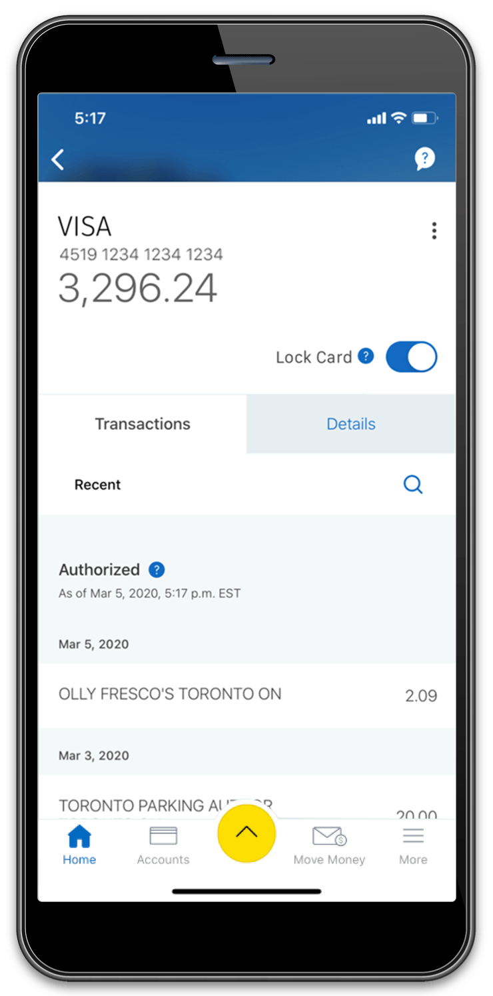
Encapsulation
Let’s highlight the value of encapsulation with a bank Account class.
Attributes:
Account owner’s name.
Current account balance.
Methods:
Deposit money.
Withdraw money.
Print account balance.
Open your notebook
Click Link:
4. Bank Account Class

Slide 48
objects, classes, and methods.
Week 6 | Lecture 1 (6.1.1)

